Slide 1
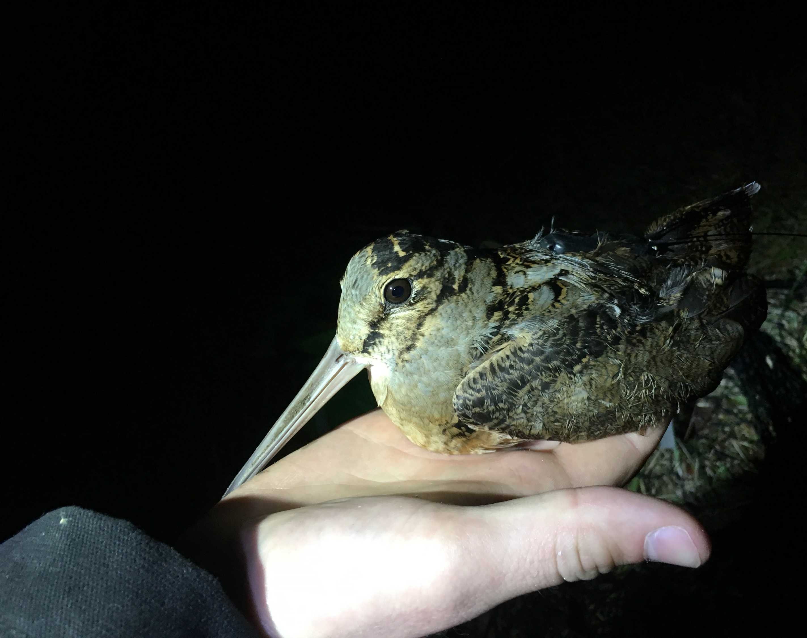
Woodcock Habitat Modeling
Third quarterly update, 4/20/2021
Liam Berigan

Slide 2
Review of overall goals
Two models:
Migratory model
Residential model
Anticipated use for the product is to determine which state lands could host woodcock stopover habitat given appropriate management

Slide 3
Review of proposed timeline
November 2020
Assemble habitat layers for the migratory model
January 2021
Have a draft product assembled for the migratory model
April 2021
Have a draft product assembled for the residential model
July 2021
All final products prepared

Slide 4
New modeling products
Migratory model
Incorporated high resolution landscape data
Residential model
Formatting Singing Ground Survey data
Modeling with random effects
Predictive layer
Variable importance

Slide 5
Predictive Variables
Landscape (1k and 5k) | Moisture | Land cover | Topography
Aggregation index | Soil drainage class | Forest | Elevation
Edge index | Topographic wetness index |  | Slope
Cohesion
Percent of landcover as forest

Slide 6
Evaluating stopover models
AUC is:
A method for evaluating the accuracy of a predictive model
The probability of correctly ranking a used/available pair
0.0 AUC
Always wrong
0.5 AUC
“Coin flip”
1.0 AUC
Always right
0.6 – 0.75
Good model
0.75 – 0.95
Excellent model

Slide 7
Improvements in the migratory model
0.70
Low Res Landscape
0.775
High Res Landscape
0.0 AUC
Always wrong
0.5 AUC
“Coin flip”
1.0 AUC
Always right
0.6 – 0.75
Good model
0.75 – 0.95
Excellent model

Slide 8
Comparison of new and old migratory layers
See attached migratory predictive layer
The overall pattern (local, with some regional hotspots) is similar

Slide 9
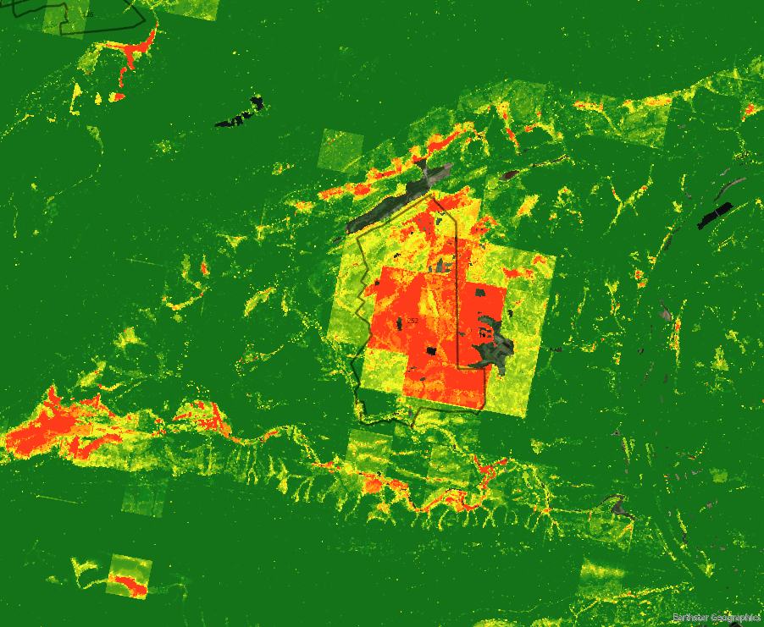
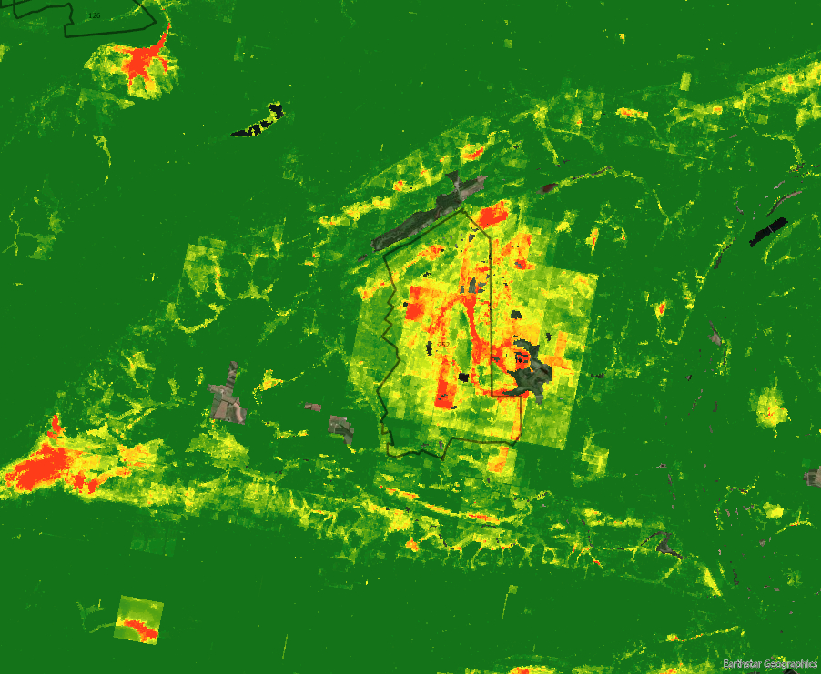
Predictions on State Game Land 252
Before:
After:

Slide 10
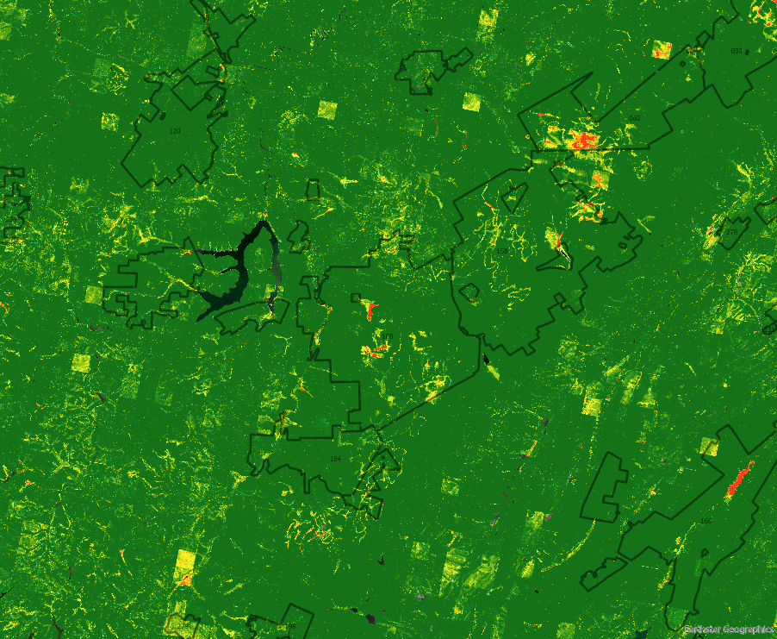
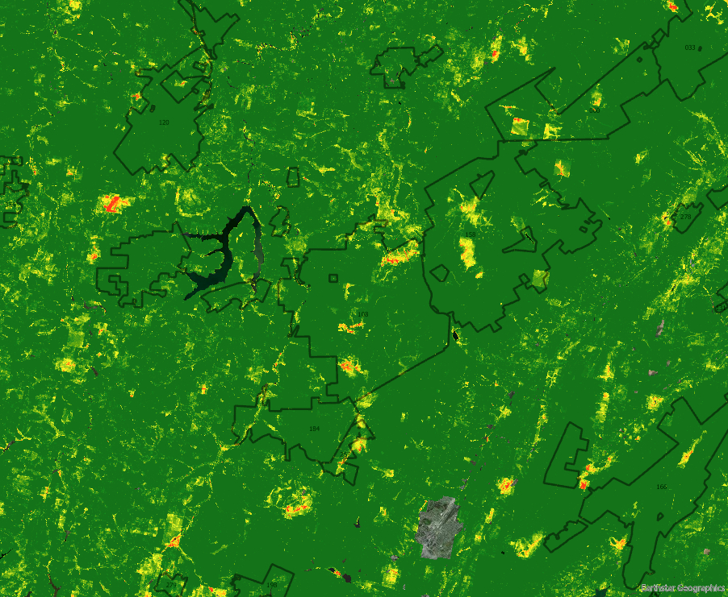
Predictions on State Game Land 108
Before:
After:

Slide 11
Residential model planning
Two sources of potential data
Pre-migratory data from tagged birds
Survey data (federal, state)
We elected to use survey data for both prediction and evaluation
Pros:
Statewide, most directly comparable to the migratory layer
Allows comparison between state game lands in different regions
Cons:
No state game land layers

Slide 12
Formatting Singing Ground Survey Data
If a point included a location at least once in the last 5 years, marked present
Otherwise, absent
95 present points, 635 absent

Slide 13
Modeling with random effects
Transect survey data has more spatial autocorrelation than migratory stopover points
Account for autocorrelation using route number as a random effect
Random Forest with Random Effects
Iterates through random forest models with linear random effects removed until log likelihoods converge

Slide 14
Evaluating the residential model
0.68
Residential model
0.0 AUC
Always wrong
0.5 AUC
“Coin flip”
1.0 AUC
Always right
0.6 – 0.75
Good model
0.75 – 0.95
Excellent model

Slide 15
Comparative predictive layers
Migratory:
Local scale
Flat areas of fragmented forest
Residential:
Regional scale
Highly forested regions in west and northeast
Notes:
Residential habitat
Focused in highly forested regions
Avoiding the southeast (very agricultural) and north central (high slope, little edge habitat)

Slide 16
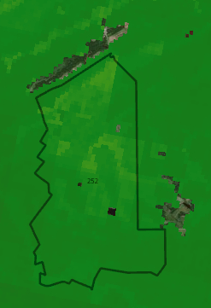
Predictions on State Game Land 252
Migratory:
Residential:

Slide 17
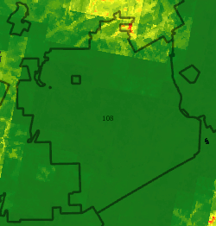
Predictions on State Game Land 108
Migratory:
Residential:

Slide 18
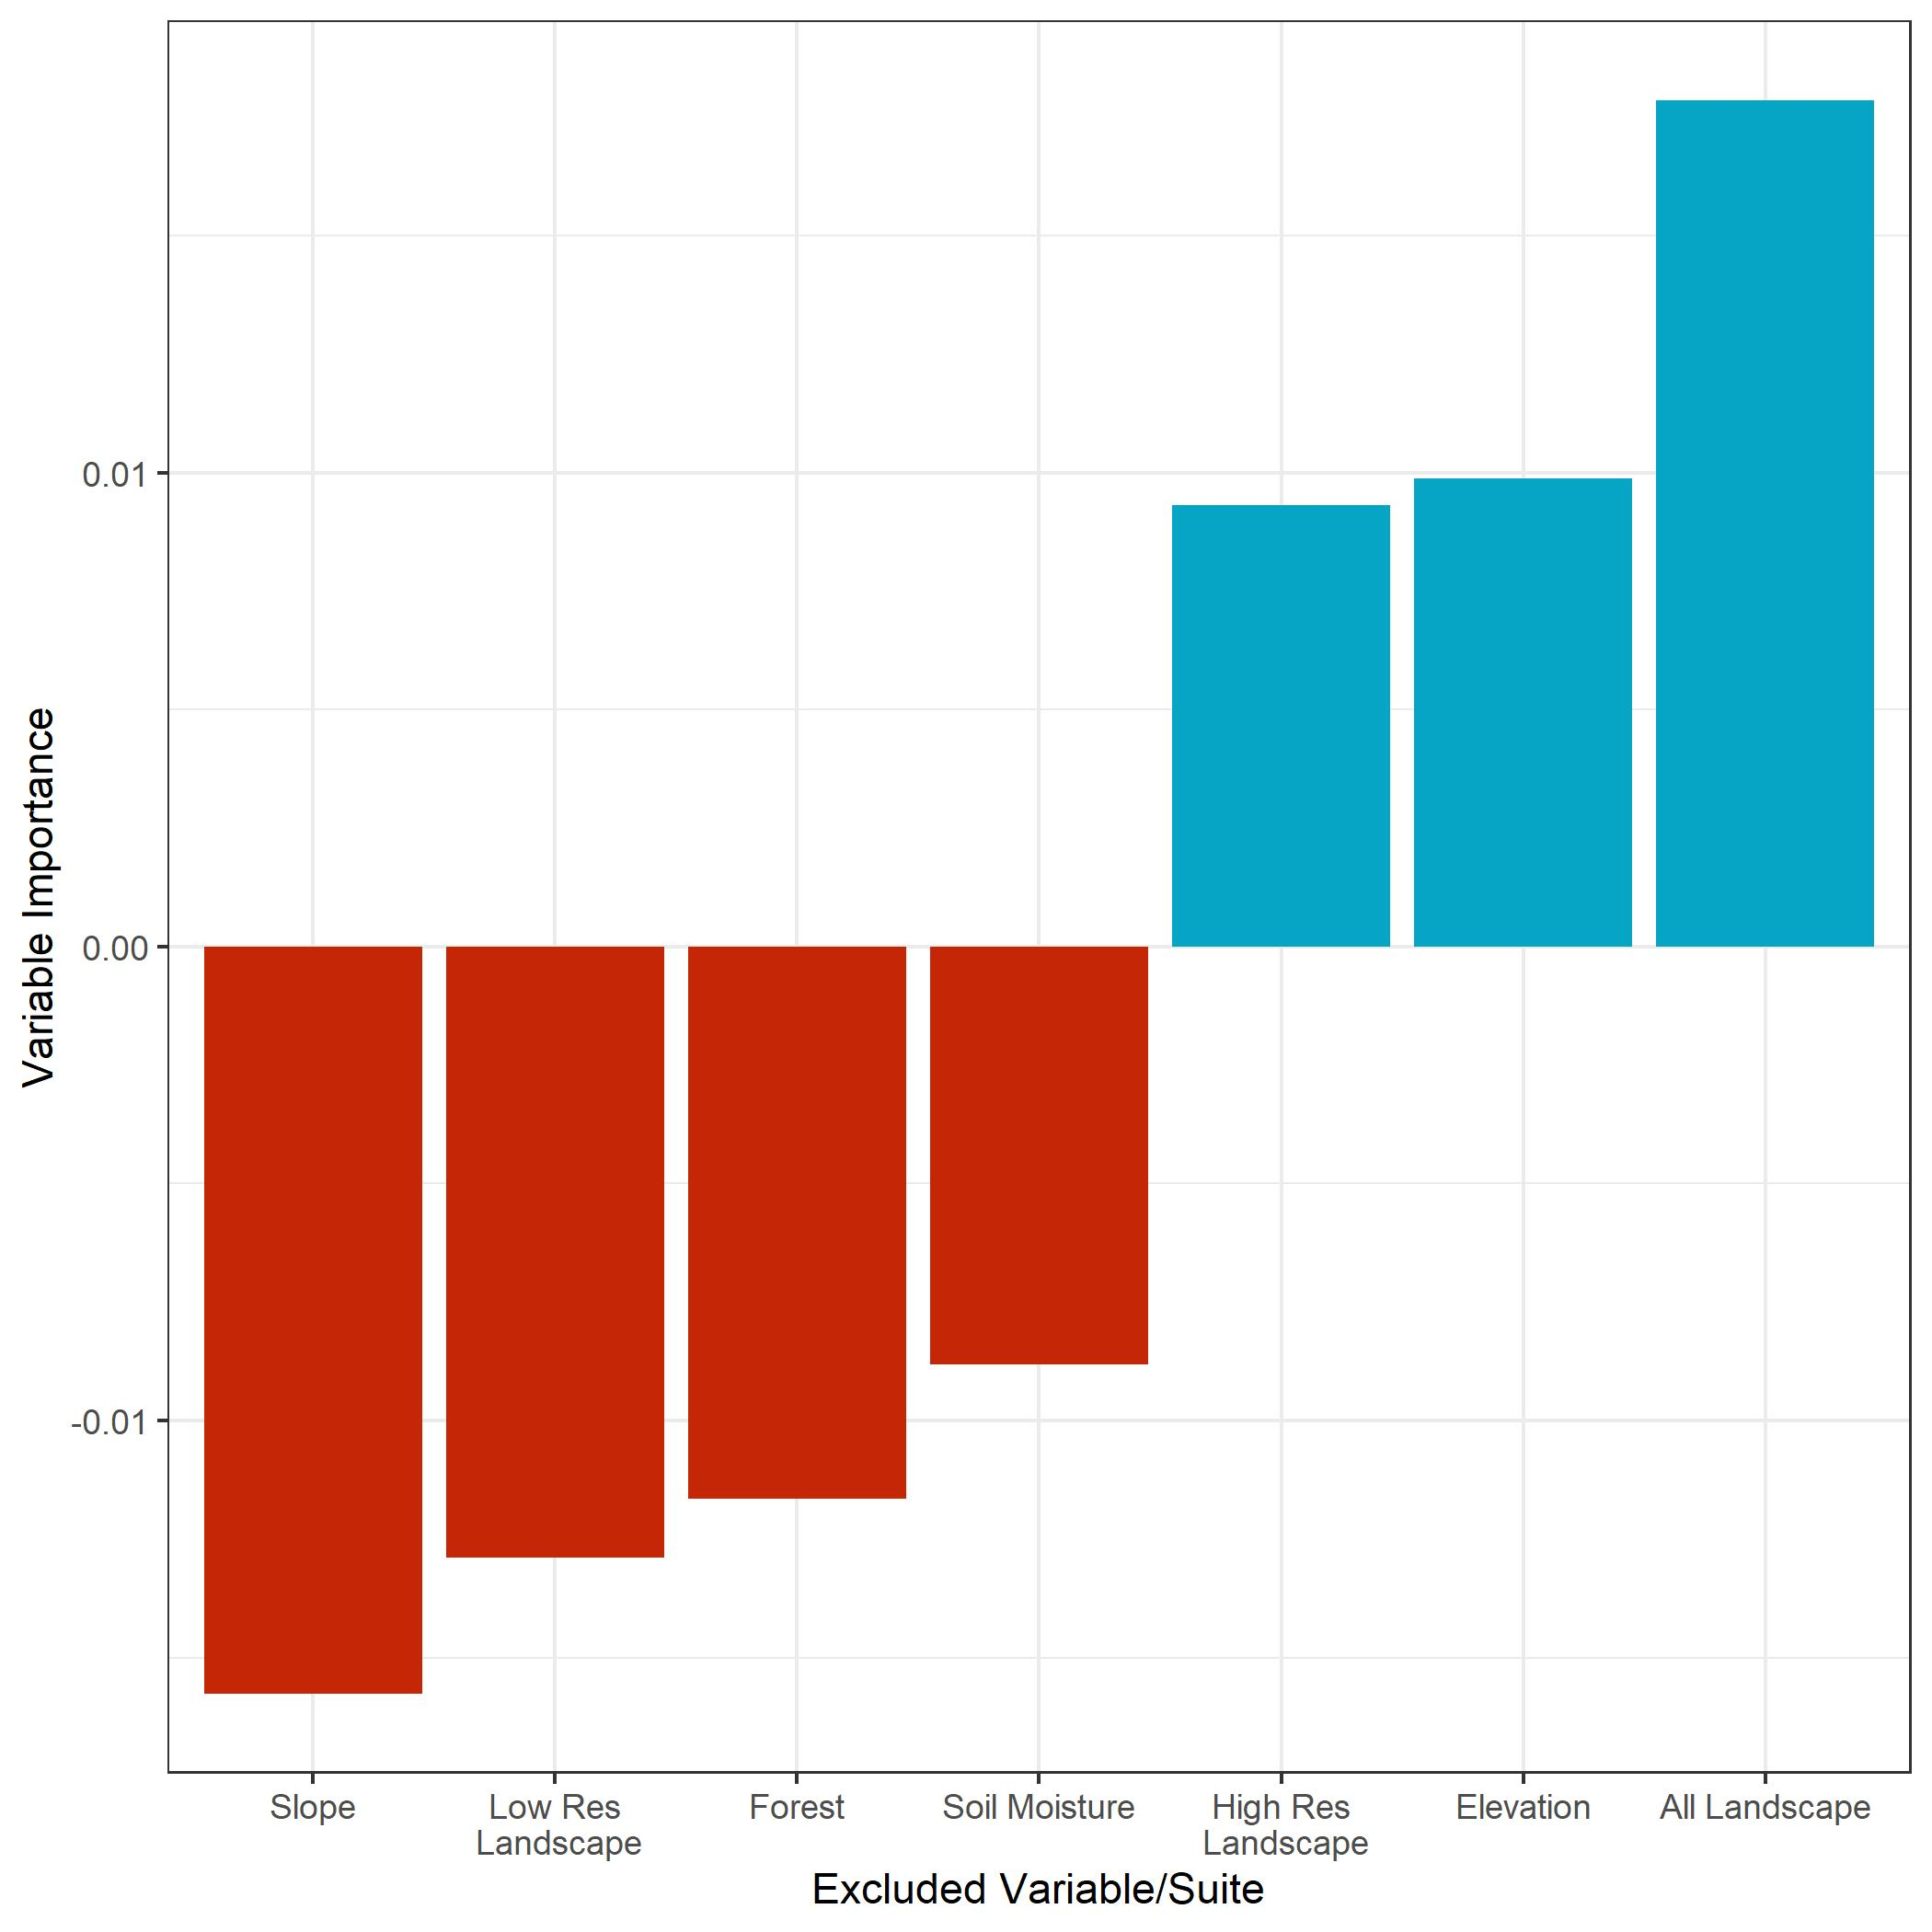

Slide 19
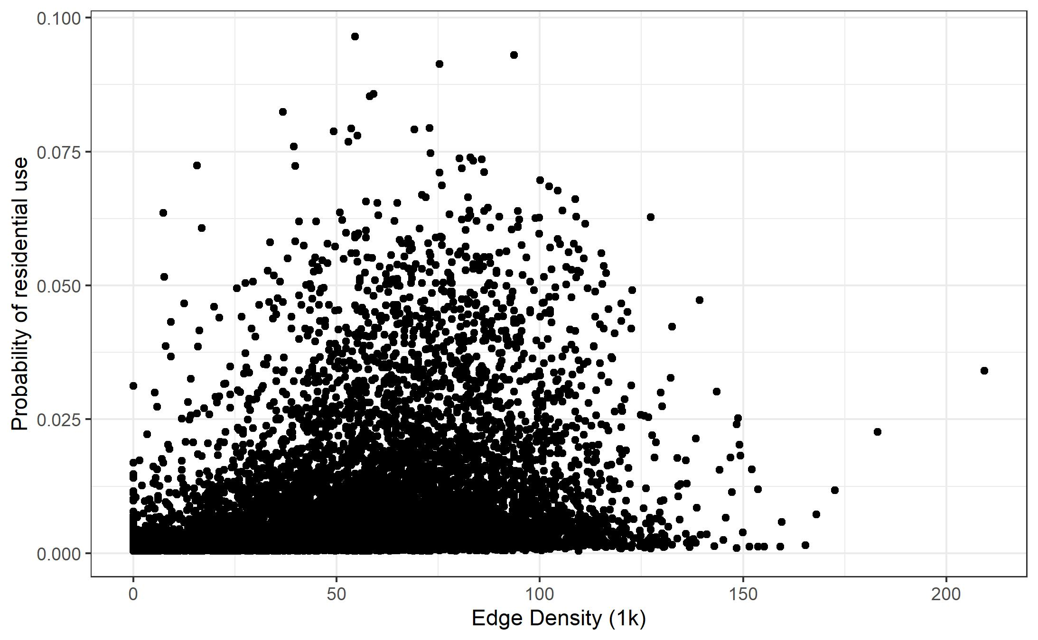
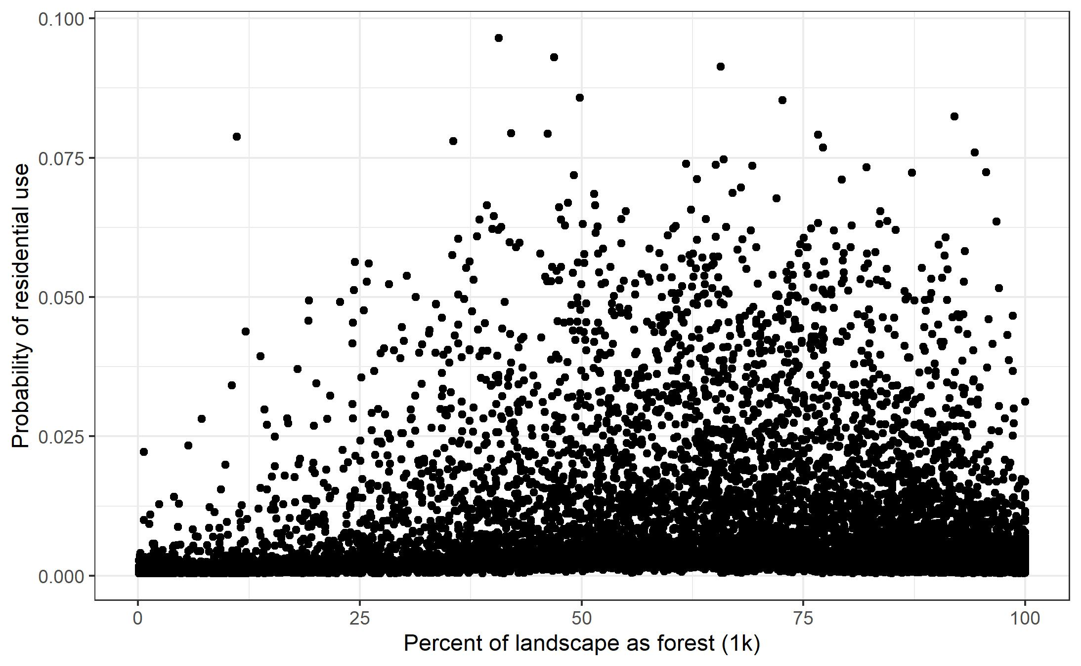
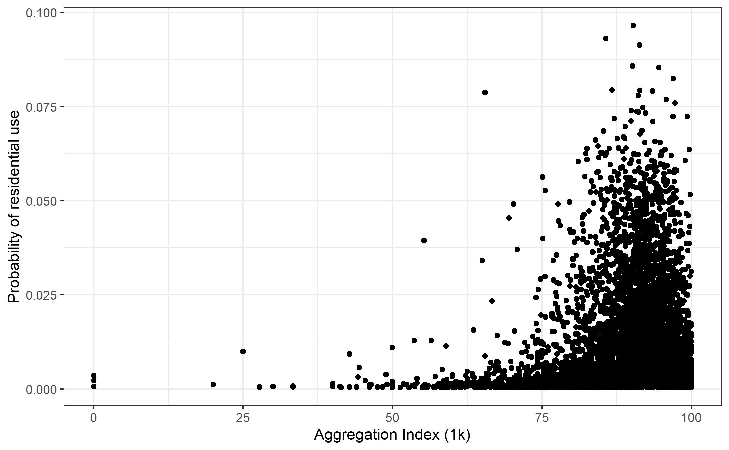
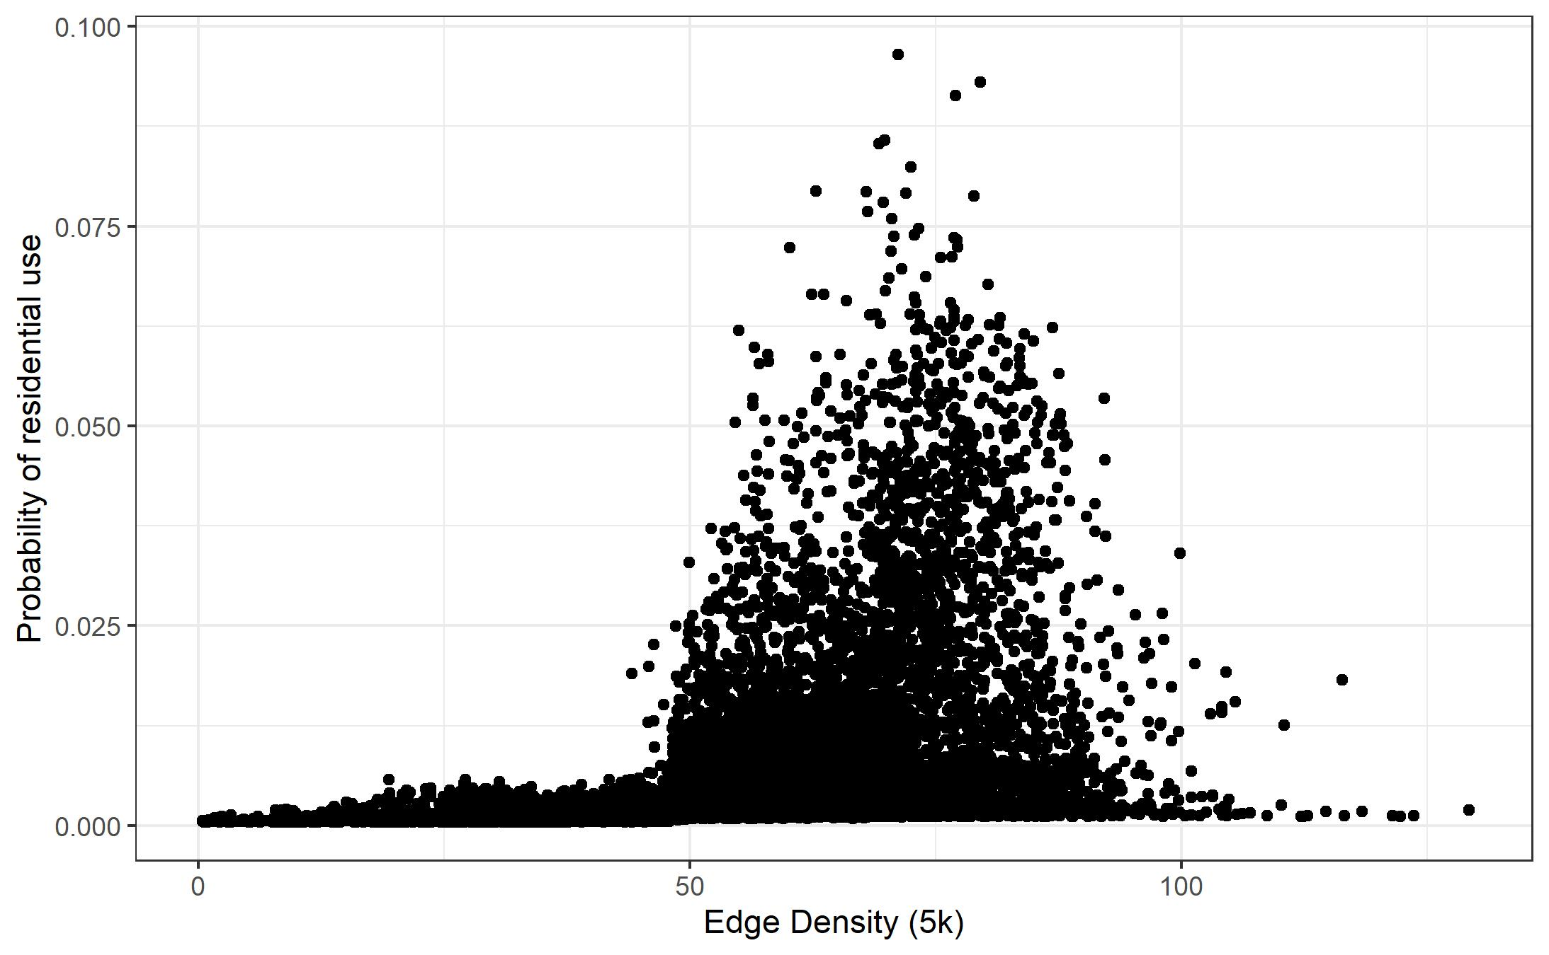
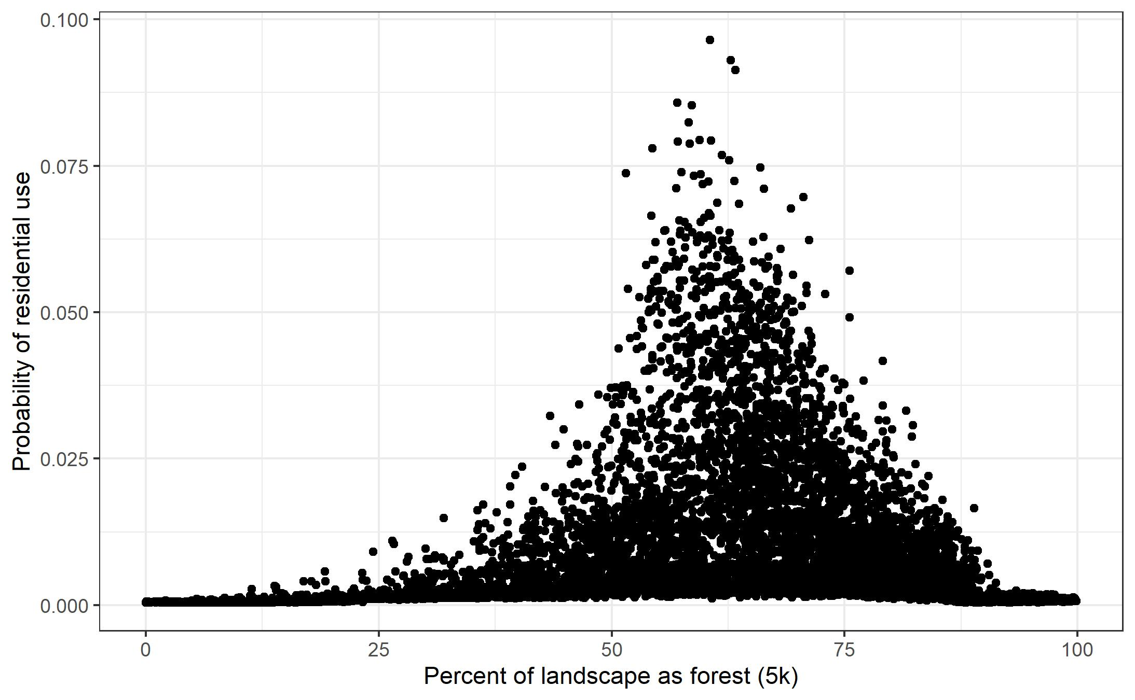
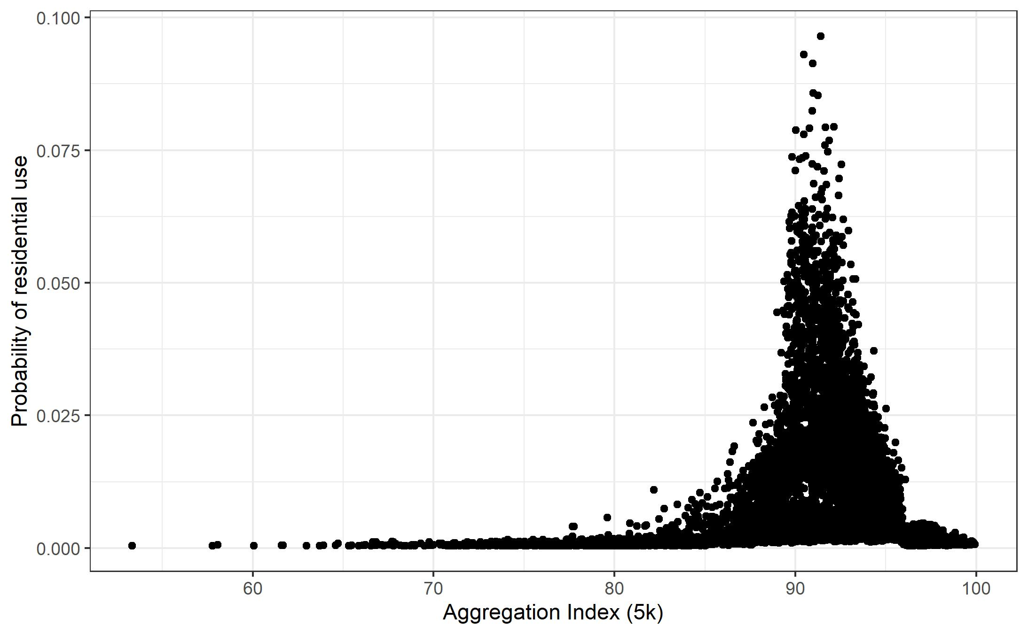
1k
Edge
% Forest
Aggregation
5k

Slide 20
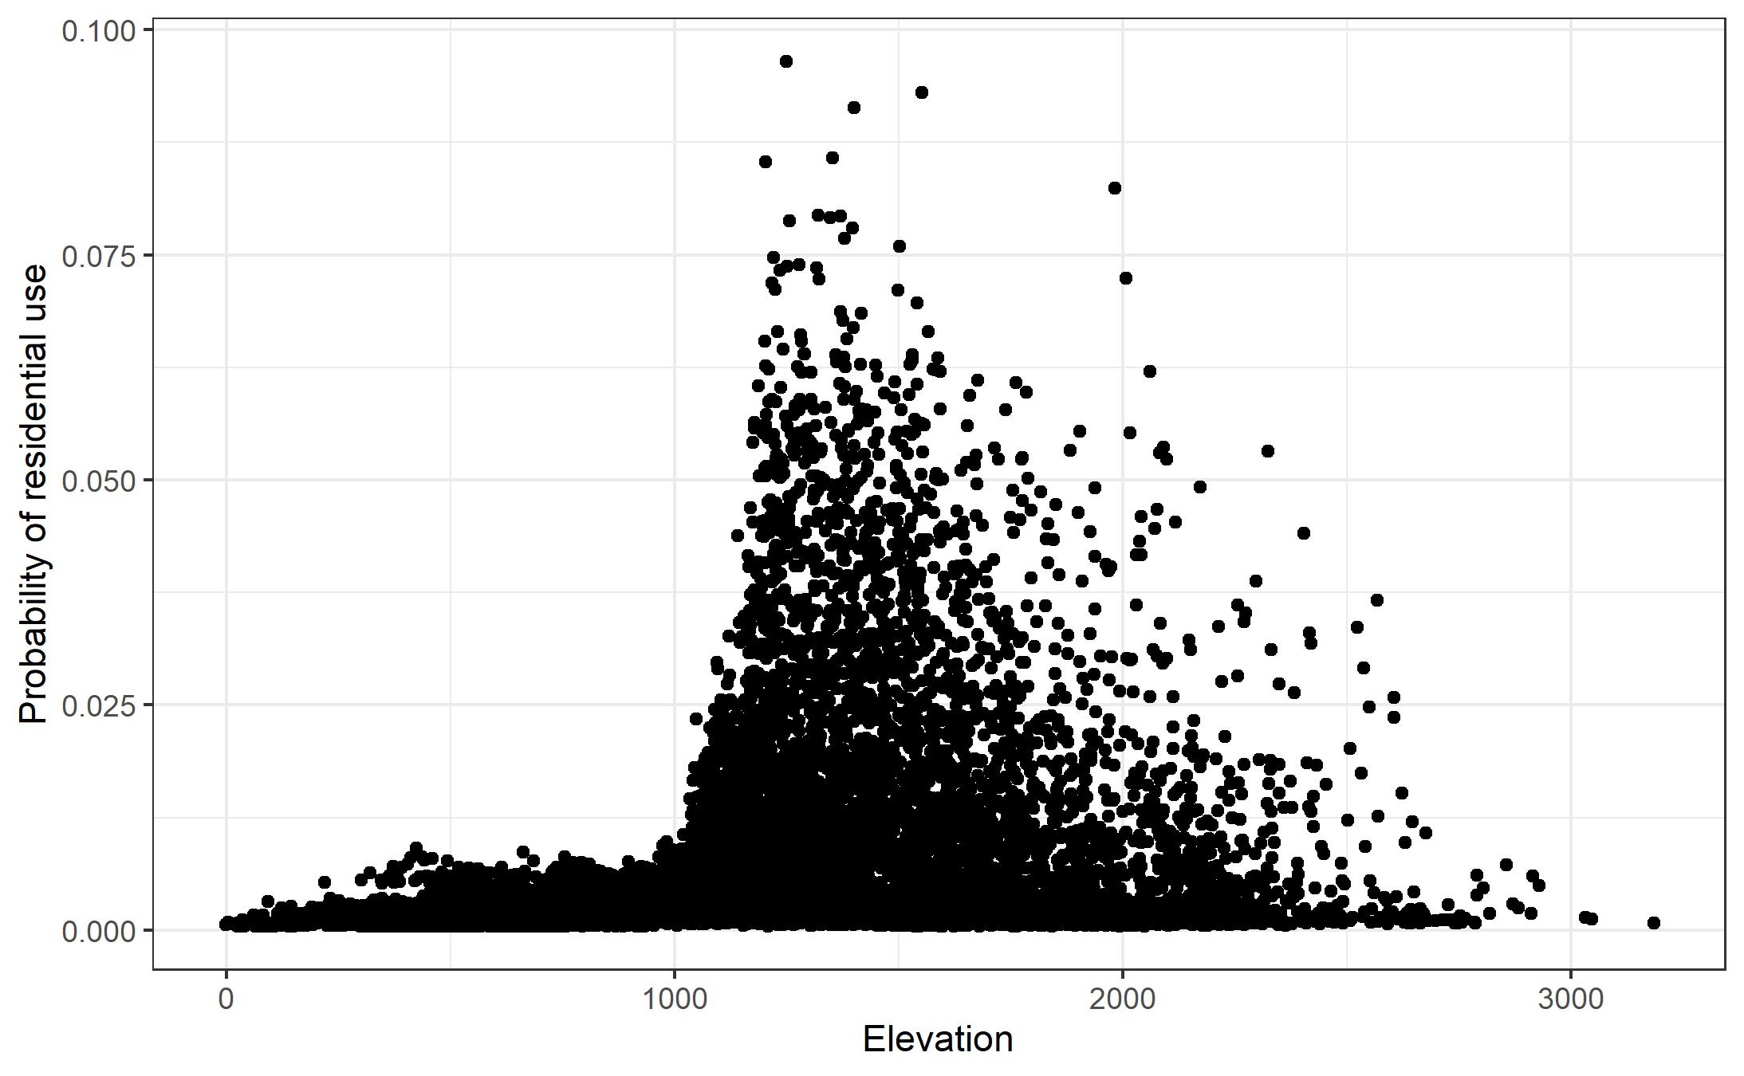
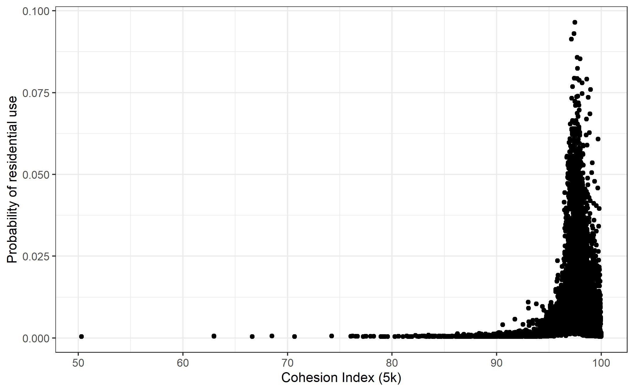

Slide 21
Finishing up the residential model
Finding alternative predictors to elevation that better explain regional patterns
Agriculture
Developed
Adding any new state data

Slide 22
Next steps
Strategies for combining inferences from these layers
Allow weighting layers at a user level
Shiny app
Integrating these layers into the report
Ranking state game lands?
Other public lands, private lands
Identify regional hotspots?
Potential areas for acquisition/protection?

Slide 23
Wrapping up
Finalize habitat models and Shiny app for review by June 30th
Progress meeting in late June
Report submitted no later than September 30th
Begin preparing manuscript for journal submission once report is complete

Slide 24


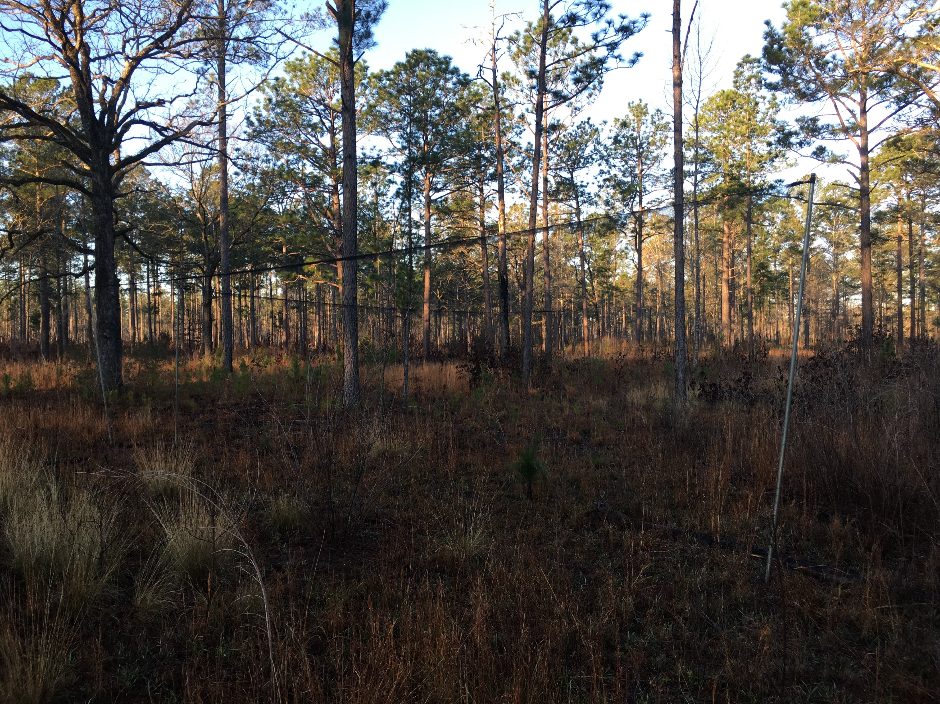

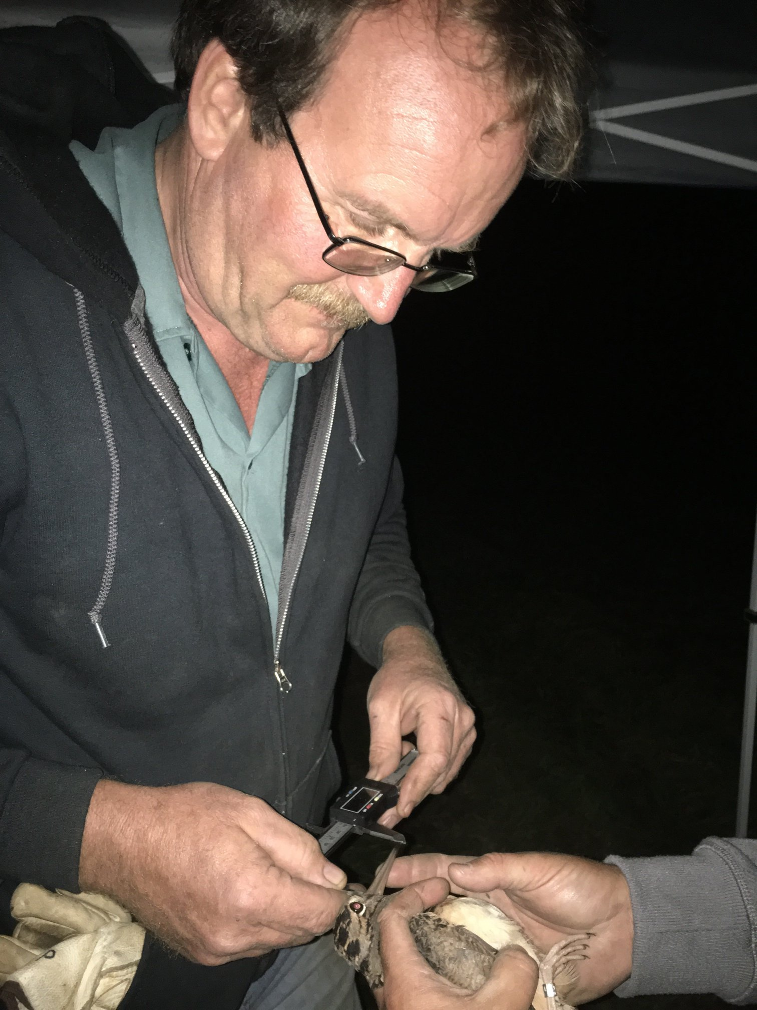
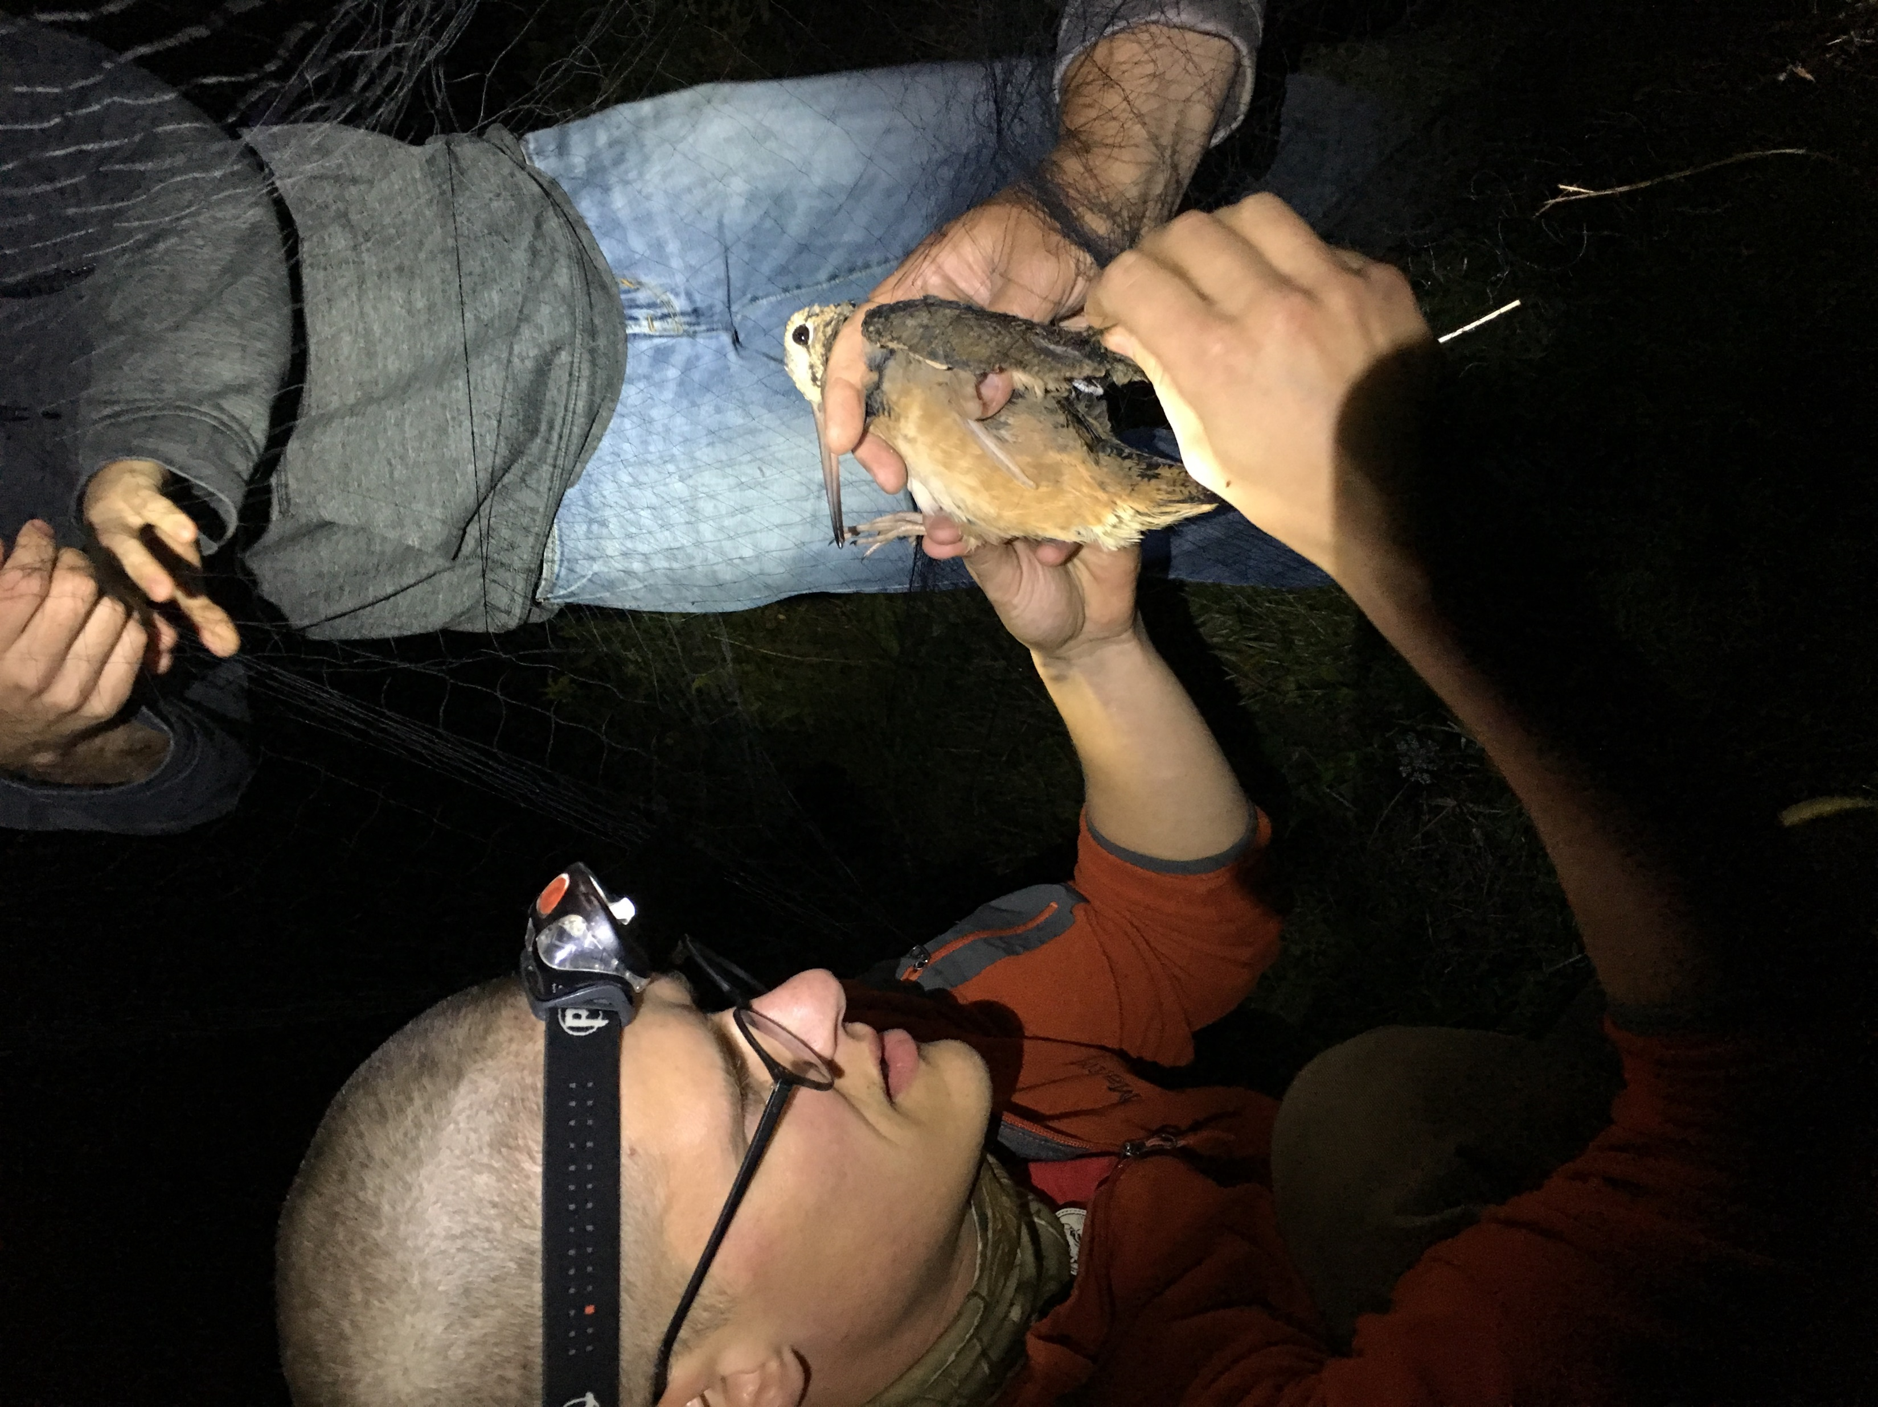
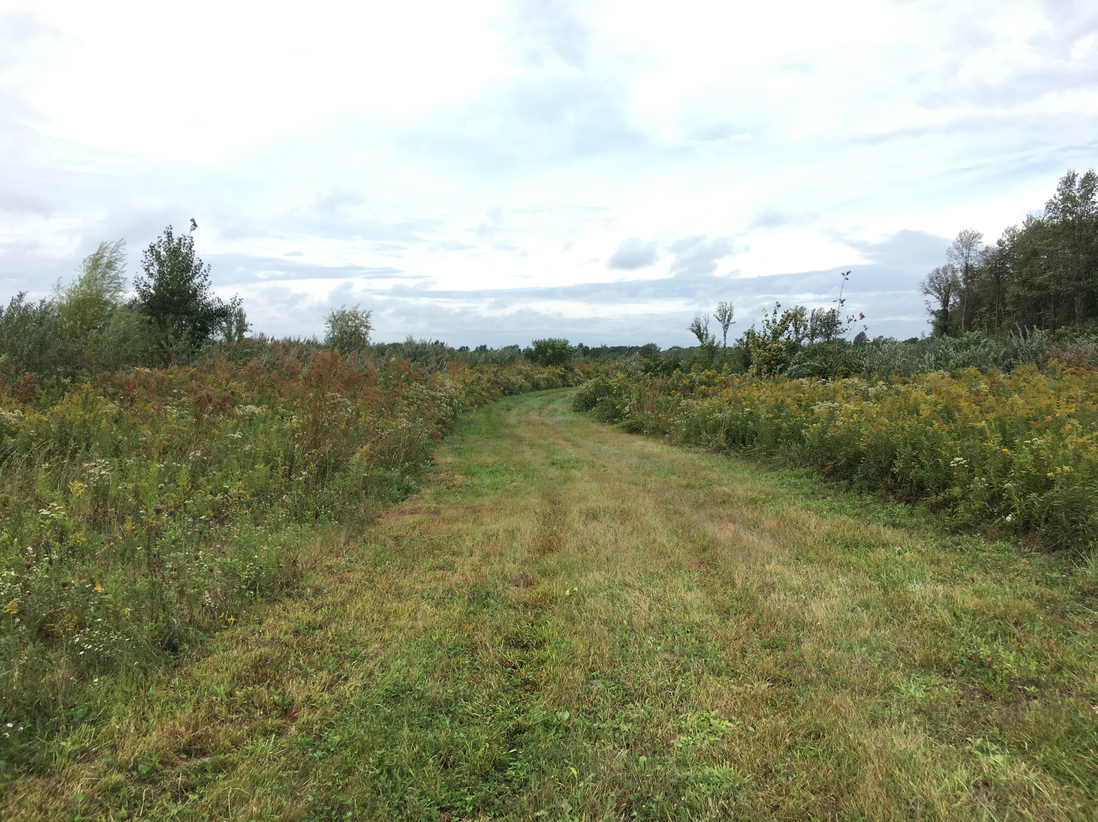
Thank you!

